Slide 1
Manual Operations
Notes:
IQ4 is the next generation of commercial central control product. Any irrigation systems controlled by ESP-LX controllers can now be fully accessed from any device with web browsing capability through IQ4. IQ4 is a web browser based application that does not require any program installation. IQ4 is next generation of IQ product that is designed for enhanced use interface through streamlined navigation.

Slide 2
Manual Operations
Manual Operations are easy in IQ4
Ability to manually start, advance and stop programs and/or stations
If a flow sensor has been installed, real-time flow showing expected flow and actual flow can be displayed

Slide 3
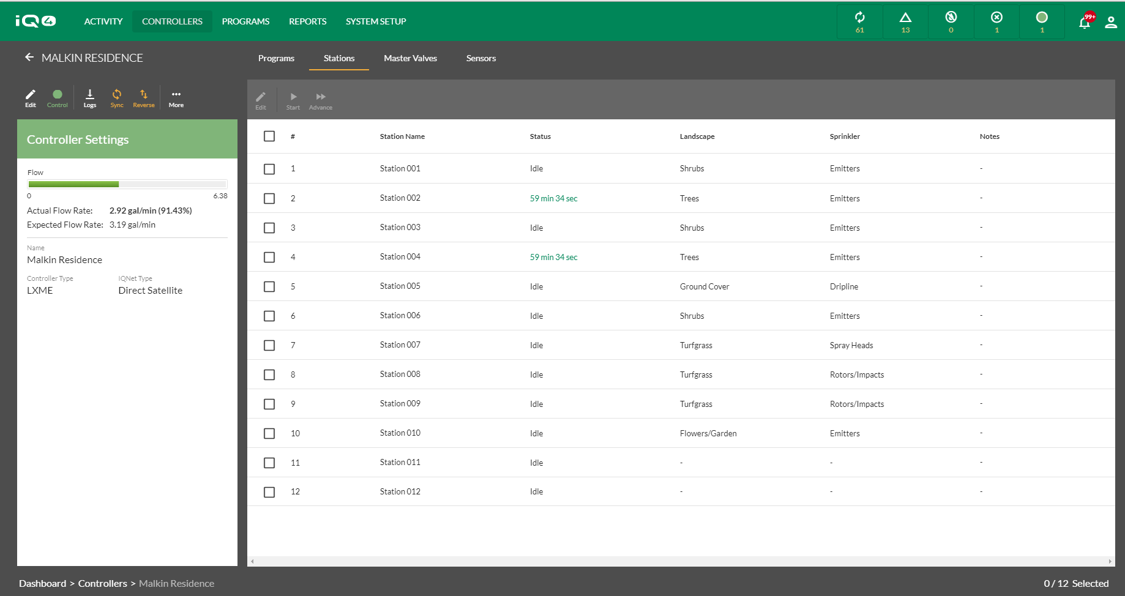
With Rain Bird’s IQ4, it is easy to start, advance and stop stations and programs manually from your mobile device or computer

Slide 4
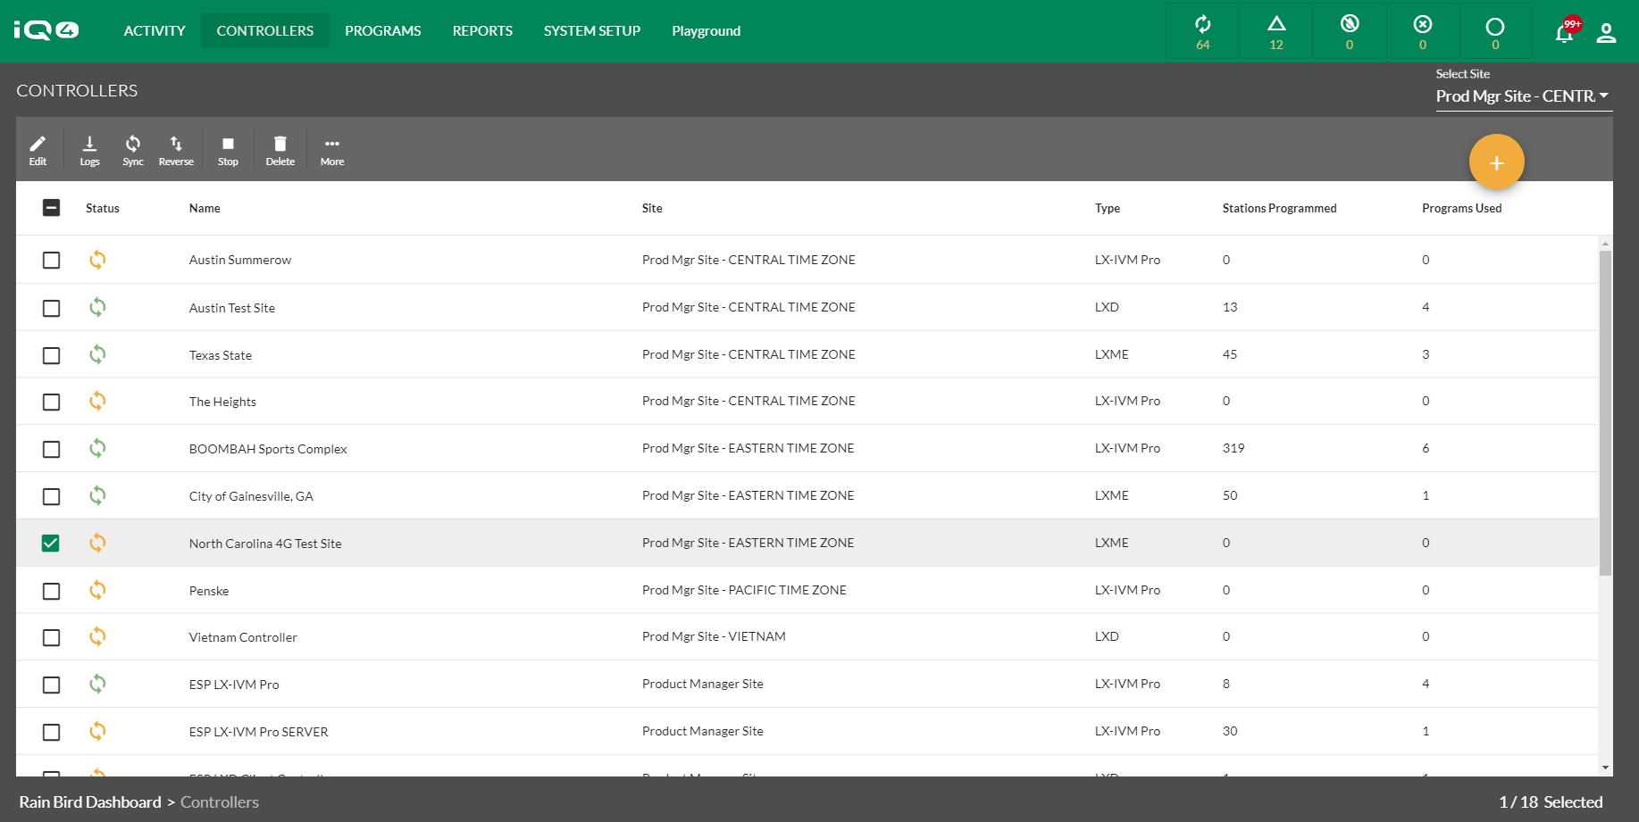
Once a controller has been setup in IQ4, navigate to the controller list screen and select the controller you would like to operate by clicking on the name of the controller

Slide 5
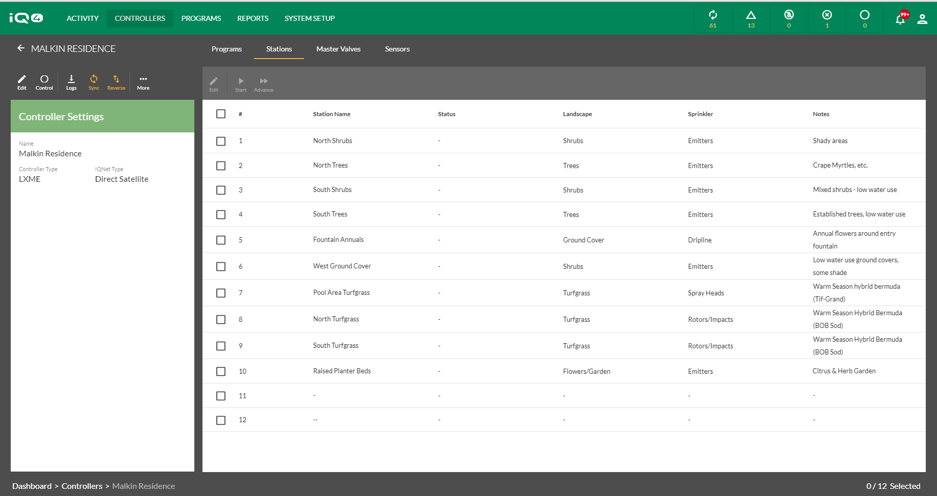
Select the Control icon to connect to the controller

Slide 6
Navigate to the Programs or Stations page depending on which you would like to operate
Select the Control icon to connect to the controller
Navigate to the Programs or Stations page depending on which you would like to operate

Slide 7
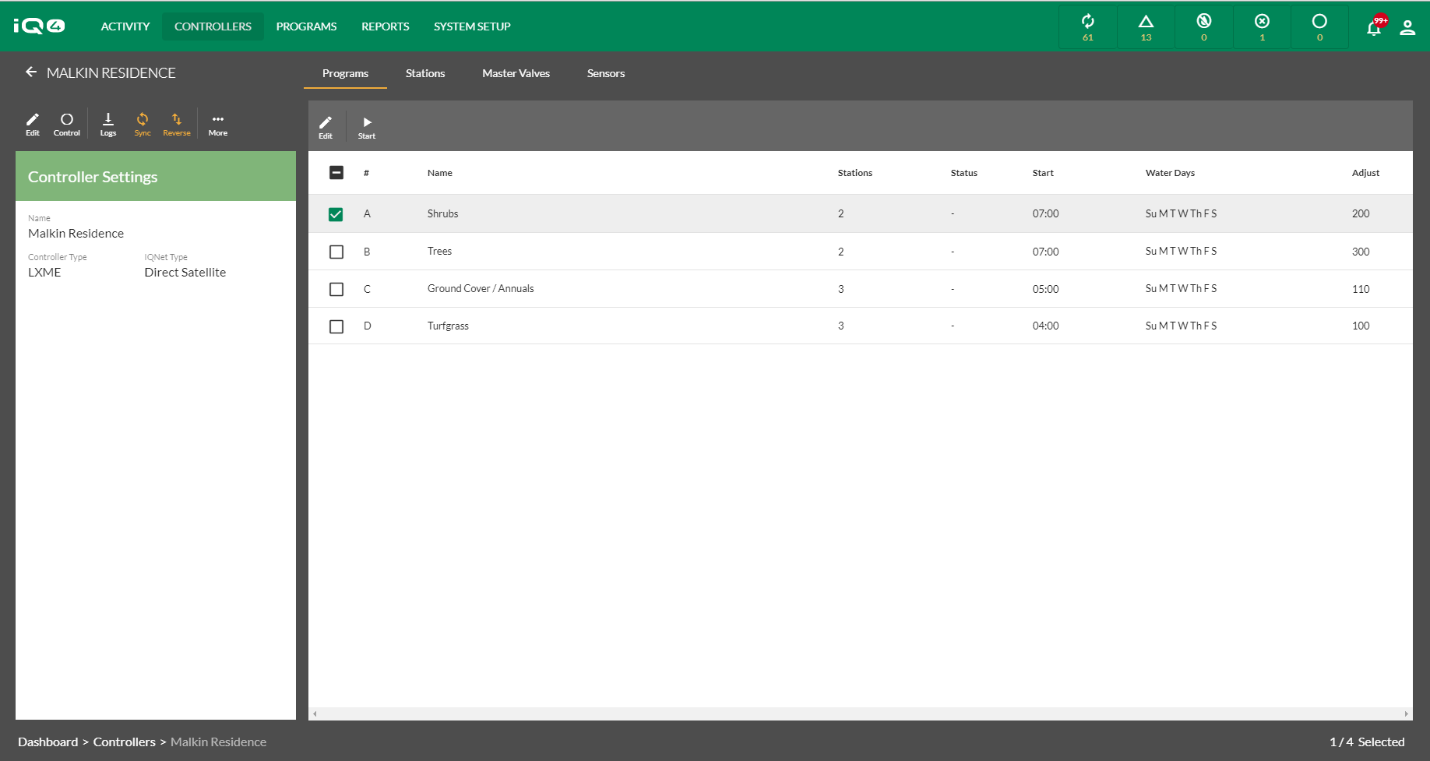
Navigate to the Programs or Stations page depending on which you would like to operate
For starting a Program, select the program then click on the Start icon

Slide 8
Navigate to the Programs or Stations page depending on which you would like to operate
For starting a Program, select the program then click on the Start icon

Slide 9
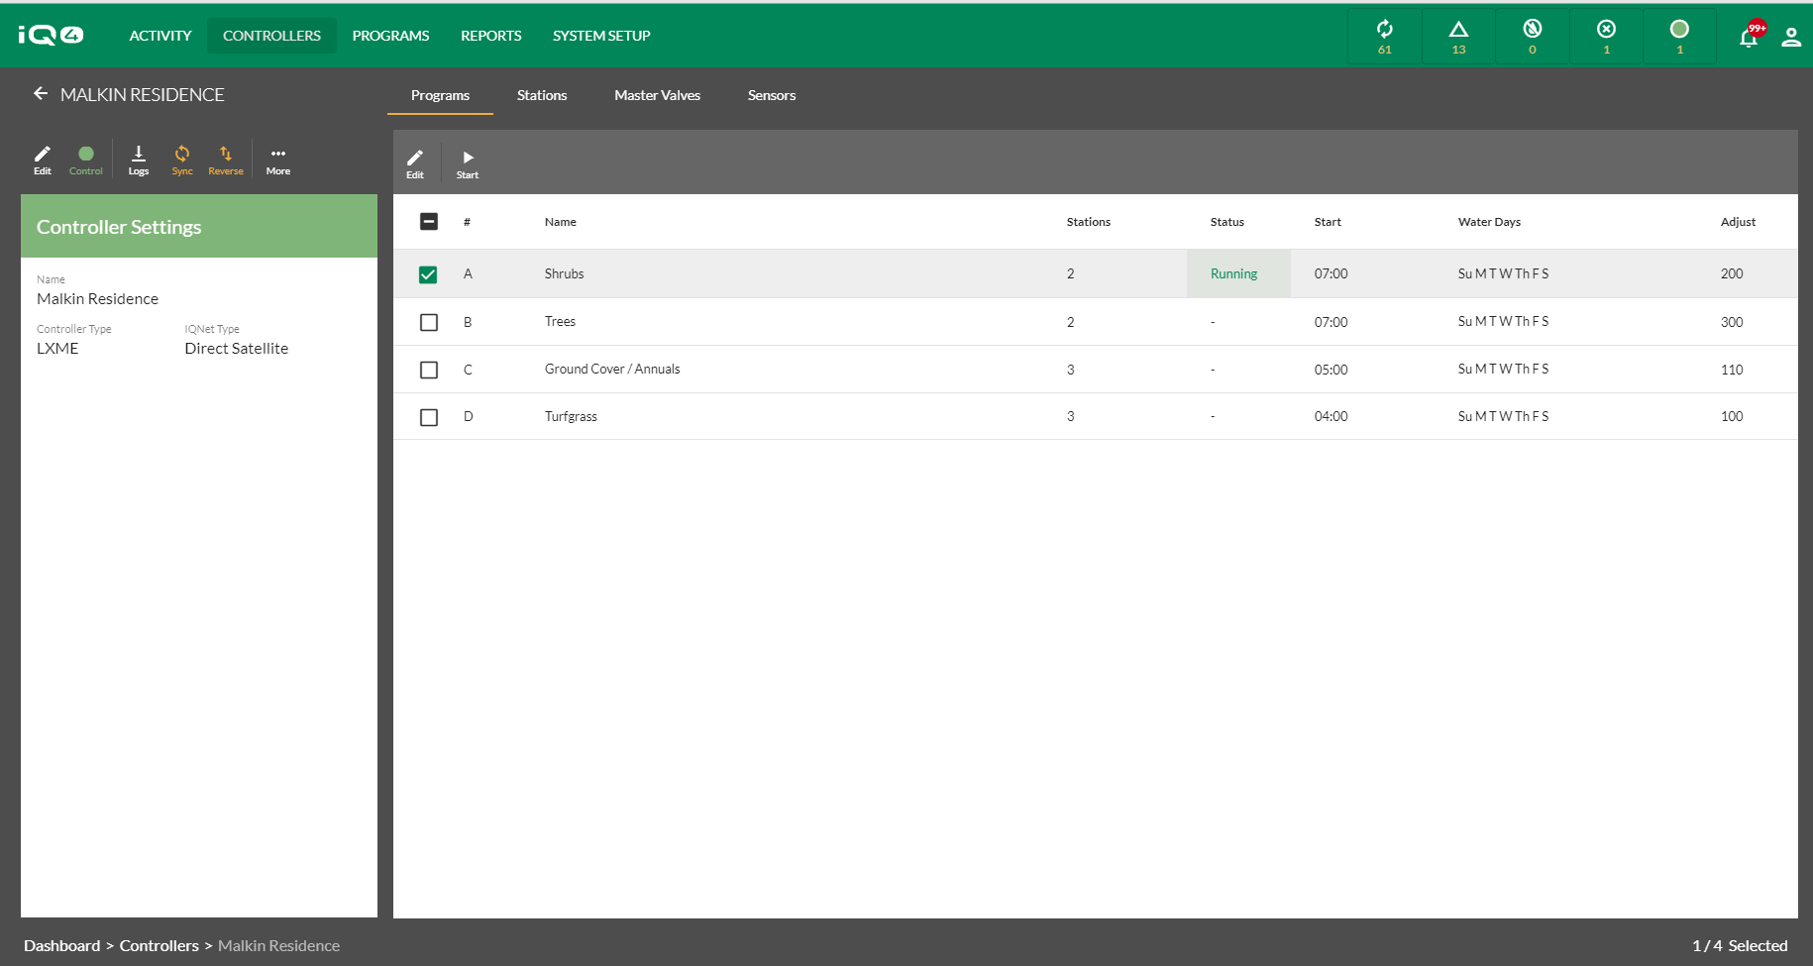
Navigate to the Programs or Stations page depending on which you would like to operate
IQ4 will contact the controller and start the program then display the operating program
IQ4 will contact the controller and start the program then display the operating program

Slide 10
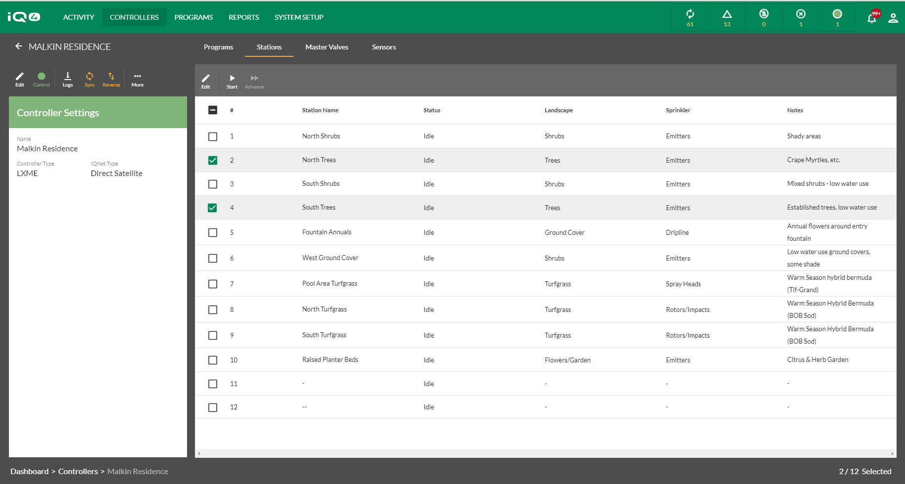
Navigate to the Programs or Stations page depending on which you would like to operate
To start one or more stations, select the Stations selection and the stations to operate

Slide 11
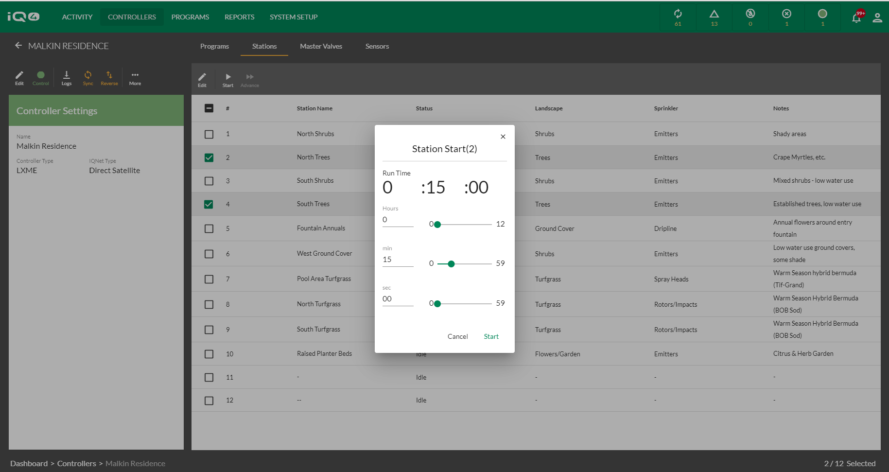
Navigate to the Programs or Stations page depending on which you would like to operate
Select Start and identify a runtime. Click on Start to begin manual station operation

Slide 12
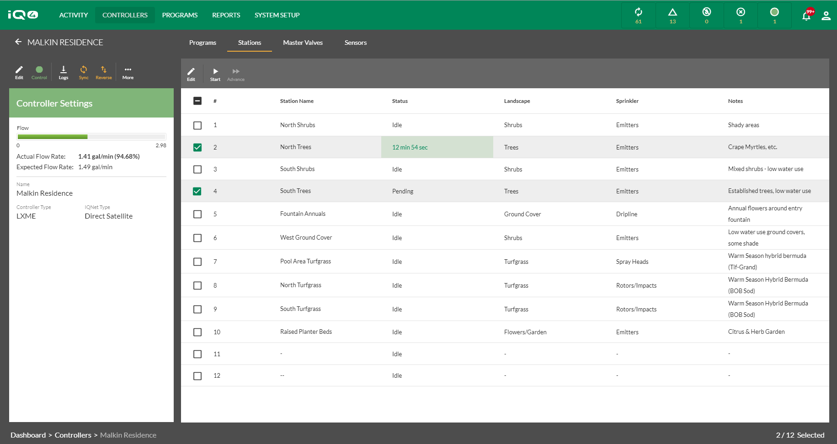
Navigate to the Programs or Stations page depending on which you would like to operate
IQ4 will display the stations that are operating and the remaining runtime or pending if waiting to operate

Slide 13
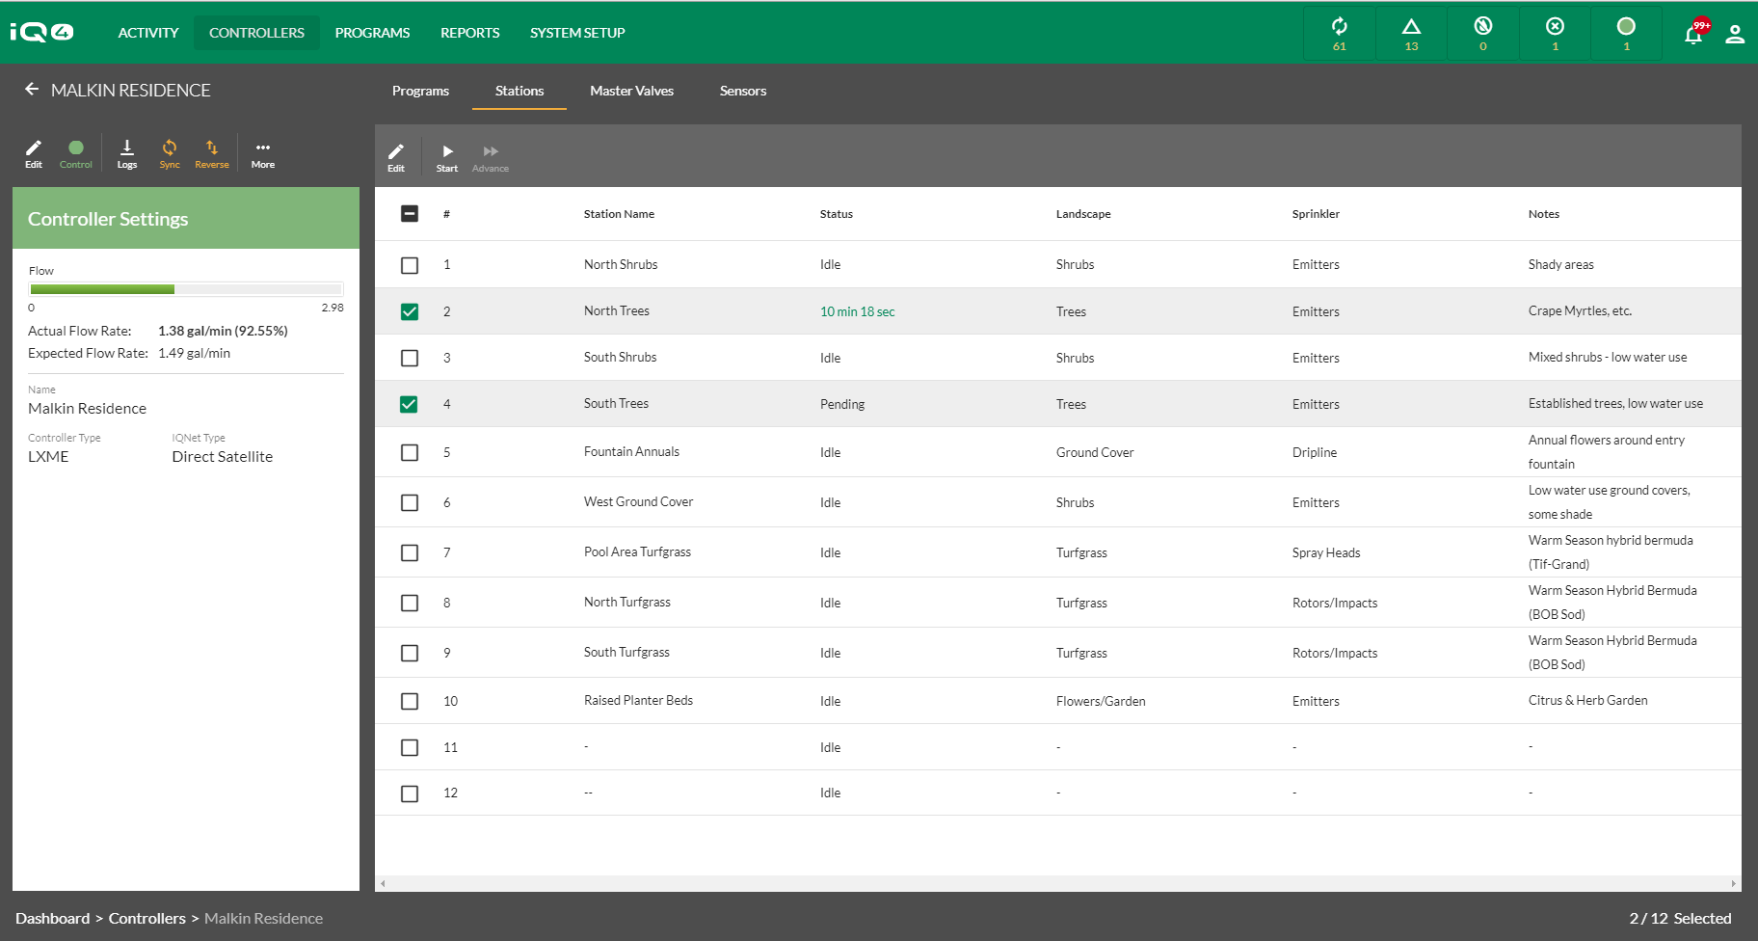
Navigate to the Programs or Stations page depending on which you would like to operate
IQ4 will display Actual Flow Rate and Expected Flow Rate if a flow sensor is installed and programmed and Flo-Watch is programmed

Slide 14
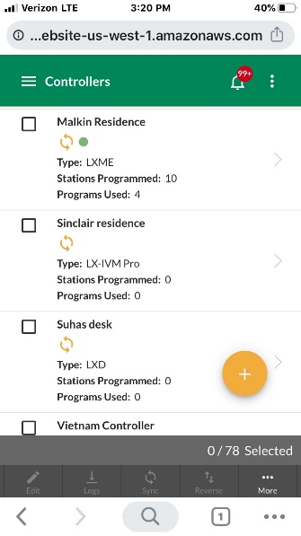
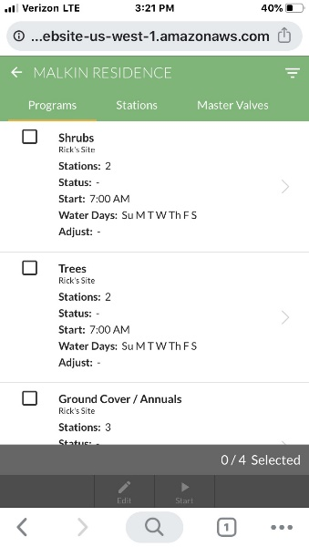
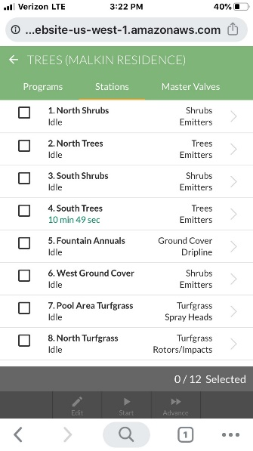
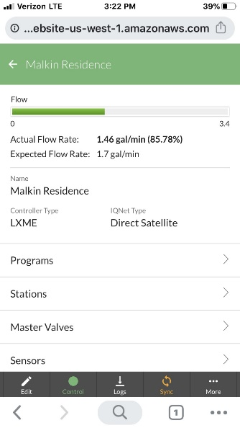
Navigate to the Programs or Stations page depending on which you would like to operate
Manually operating programs and stations from a mobile device is identical to operating from IQ4 on a desktop computer

Slide 15
Frequently Asked Questions

Slide 16
FAQs

